Slide 1
RRR- Mutable objects and functions
Jenny Wang, Albert Huang

Slide 2
Lesson Outline
Mutable Objects
Mutable Functions
To view these slides and get access to the worksheet, go to:
links.cs61a.org/rrr-folder
> Mutable Objects And Functions

Slide 3
Mutable Objects
Notes:
list
dictionary
Set
Immutable: tuples

Slide 4
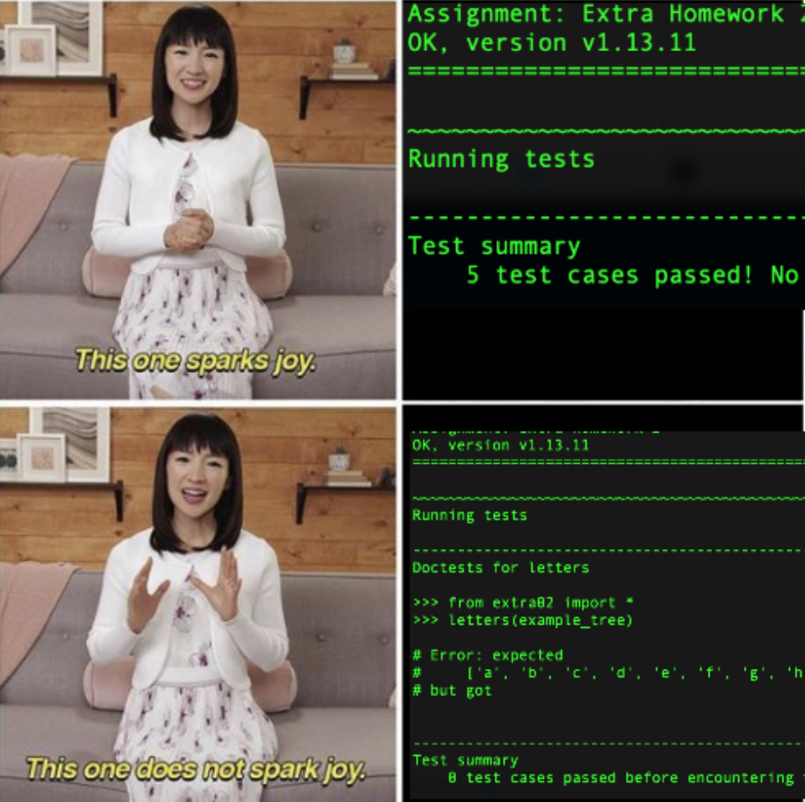
Mutable Lists
You can change the contents of the list without creating a new list:
>>> kondo = [‘this’, ‘one’, ‘does’, ‘not’]
>>> kondo.pop()
‘not’
>>> kondo.append(‘spark’)
>>> kondo.extend([‘joy’])
>>> kondo
[‘this’, ‘one’, ‘does’, ‘spark’, ‘joy’]

Slide 5
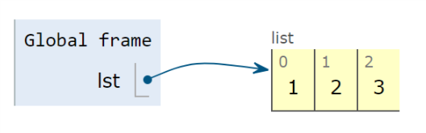
General Definitions - Pointers
Pointer is a location for an object
Instead of actually storing a list inside another list, the outer list just stores the location of the inner list
When you access the pointer of an object, you automatically go to said location and then interact with the object
lst = [1, 2, 3]
lst doesn’t actually store [1, 2, 3] but instead stores a pointer
Notes:
Treat these questions like environment diagrams
Be methodical and try to keep track exactly where you are in execution at all times
Remember when to create a new list and when you just have to move a pointer
A good time to use scratch paper
Since you will be modifying a lot of pointers and lists, it may be helpful to do work on another page
Create “snapshots” at certain execution points so if you make a mistake it’s easier to revert to a previous step

Slide 6
Methods for mutating lists
append(el) adds el to the end of the list
extend(lst) extends the list by concatenating lst to the end
insert(i, el) insert el at index i
remove(el) removes the first occurrence of el in list, otherwise errors
pop(i) removes and returns the element at index i
Notes:
Tuples ( ) aren’t mutable but lists [ ] are
Convert tuples to lists by casting

Slide 7
List Slicing
list[i:j:k]
i - starting index; inclusive
j - ending index; exclusive
k - step size
i,j,k can all be negative
last element of list has index -1
list slicing doesn't error
if the slice doesn't make sense, it returns the empty list
common uses: list[:] , list[::-1]
shallow copy of entire list, reverses the list

Slide 8
List slicing, shallow and deep copies
lst = lst_1 + lst_2
creates a new list of the elements of lst_2 tagged onto the elements of lst_1.
shallow copy - only copies pointers, doesn’t replicate inner lists
lst = lst + [1]
creates a new list with [1] tacked on
lst += [1]
mutates the original lst (same as lst.extend([1])

Slide 9
Summary
Operation | Input type | Output | What it does
lst.append(x) | x is any element (can be string or list) | None | Adds exactly 1 element to lst; uses pointer if input doesn’t fit
lst.extend(x) | x is a list | None | Puts all elements from list x at the end of the original list
lst += x | x is a list | None | (Same as above)
lst = lst + x | x is a list | None | Makes a new list
list(x) | x is an iterable | List | Iterates through input x and adds each element to a newly made list
Notes:
Will probably remake this table; replacing domain/range and also making explanation clearer

Slide 10
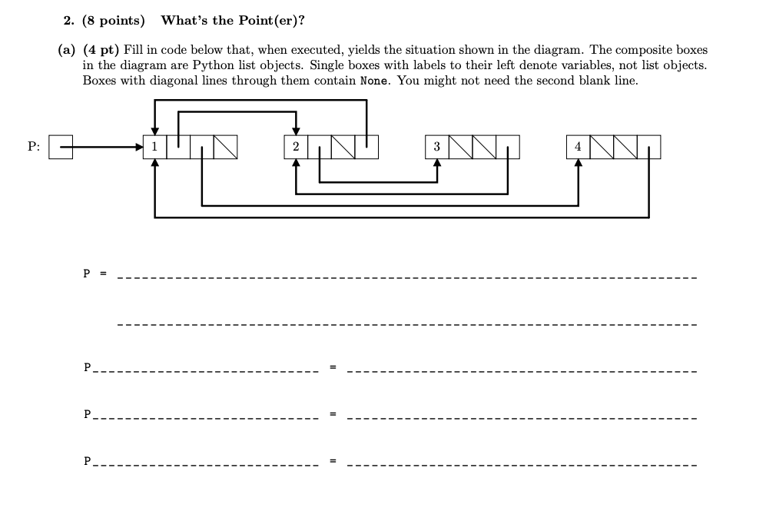
Spring ‘17 Final

Slide 11
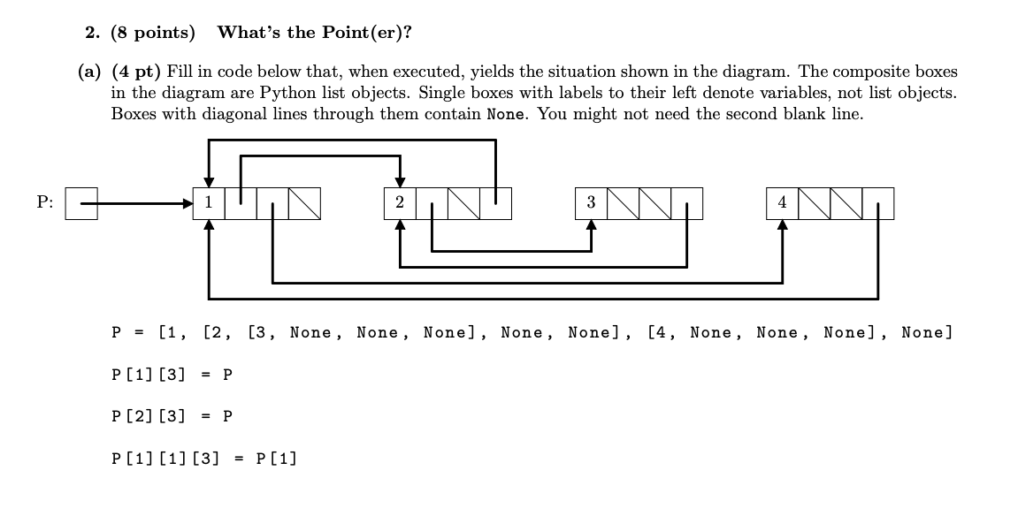
Spring ‘17 Final

Slide 12
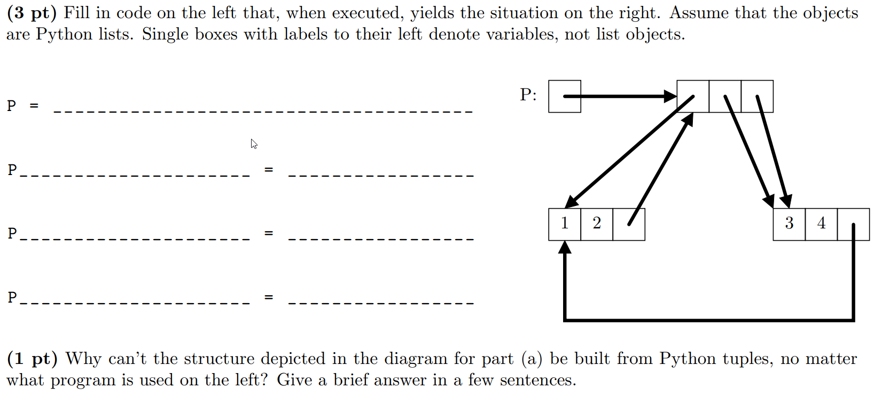
Spring ‘16 Final

Slide 13
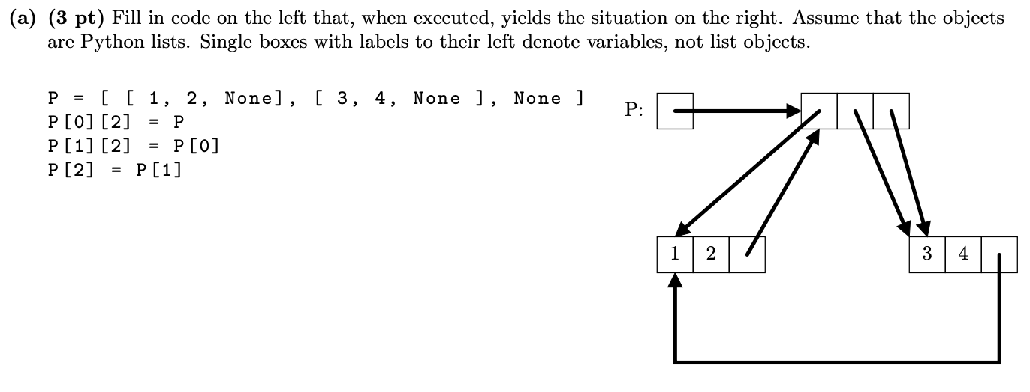
Spring ‘16 Final
Why can’t we do this with a tuple?
Since tuples are immutable (i.e. once created, cannot be changed), anything a tuple has a pointer to must exist before the tuple itself.
P cannot be created before P[0], P[0][2] cannot be set to its final value when P[0] is constructed, and must therefore be set later, which is impossible.

Slide 14
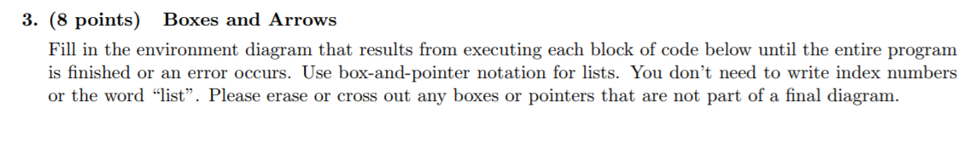
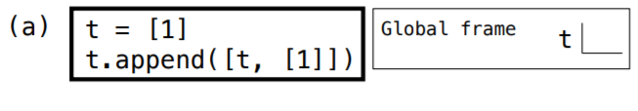
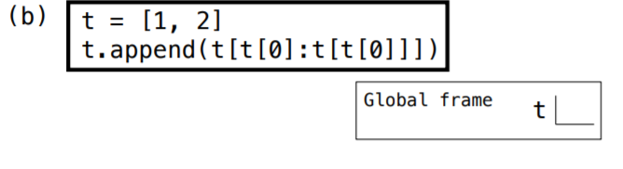
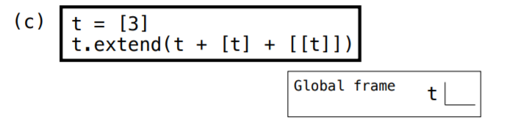
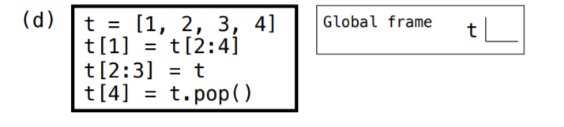
Fall ‘16 Final

Slide 15
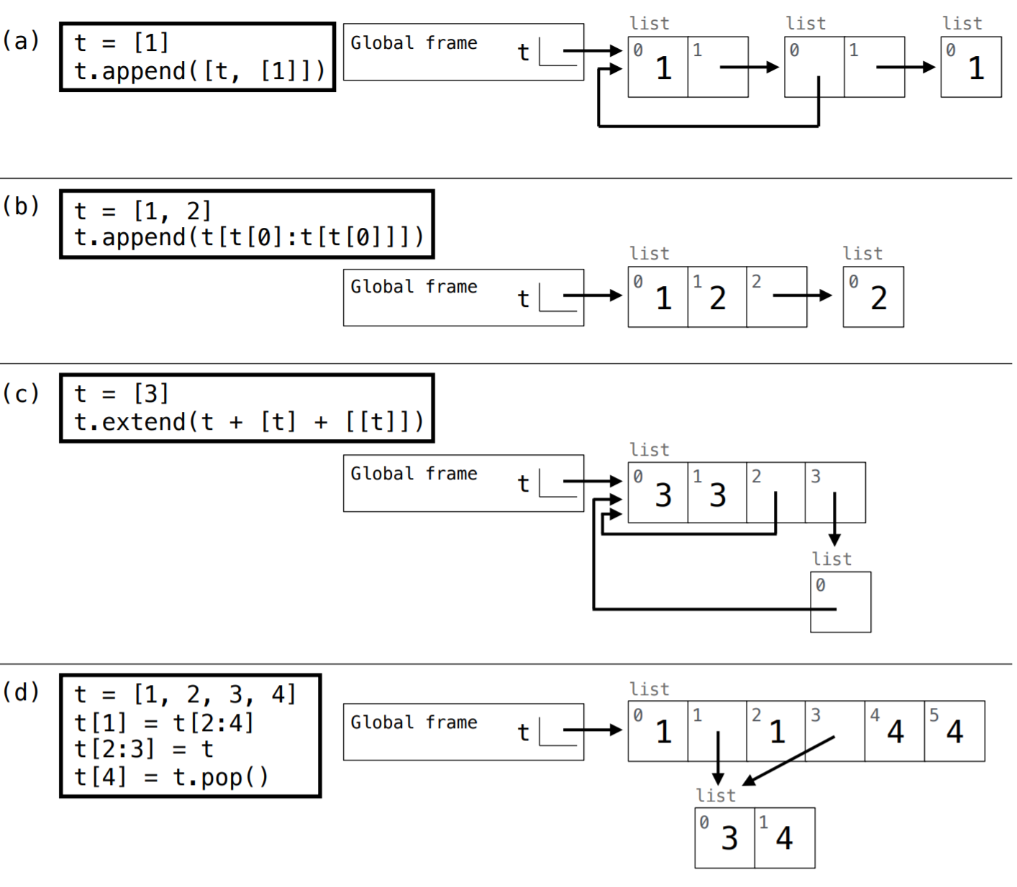
Fall ‘16 Final

Slide 16
Mutable Functions

Slide 17
Nonlocal
Different to frame lookup:
Looking up a variable in parent frame(s):
access variables in parent frames
can’t change the variables
Nonlocal:
access variables in parent frames
allows us to change variables outside the current frame
Simply declare a variable as nonlocal

Slide 18
Nonlocal
Rules
Global variables can’t be modified using nonlocal
Can’t have both local and nonlocal variables with the same name in a frame
def foo(x): def not_allowed(y): x = 3 nonlocal x x += 1 return x return not_allowed
def foo(x): def will_error(x): nonlocal x x += 1 return x return will_error

Slide 19
Example: memory
def memory(n):
def f(g):
nonlocal n
n = g(n)
return n
return f
Notes:
From discussion: ask students what this does

Slide 20
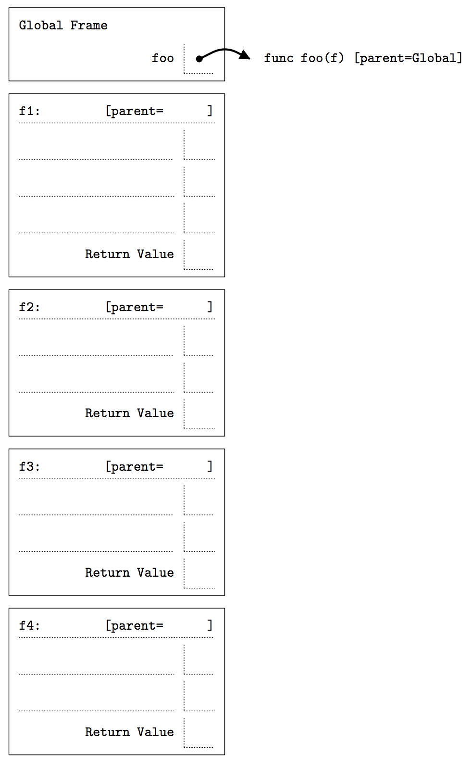
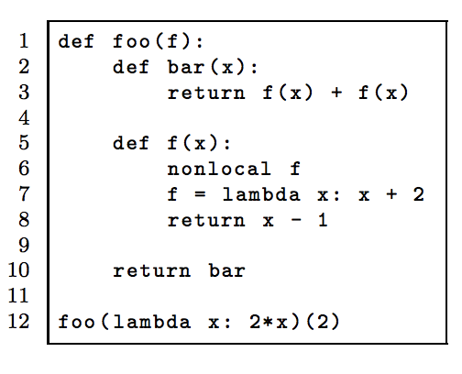
Spring ‘15 MT 2

Slide 21
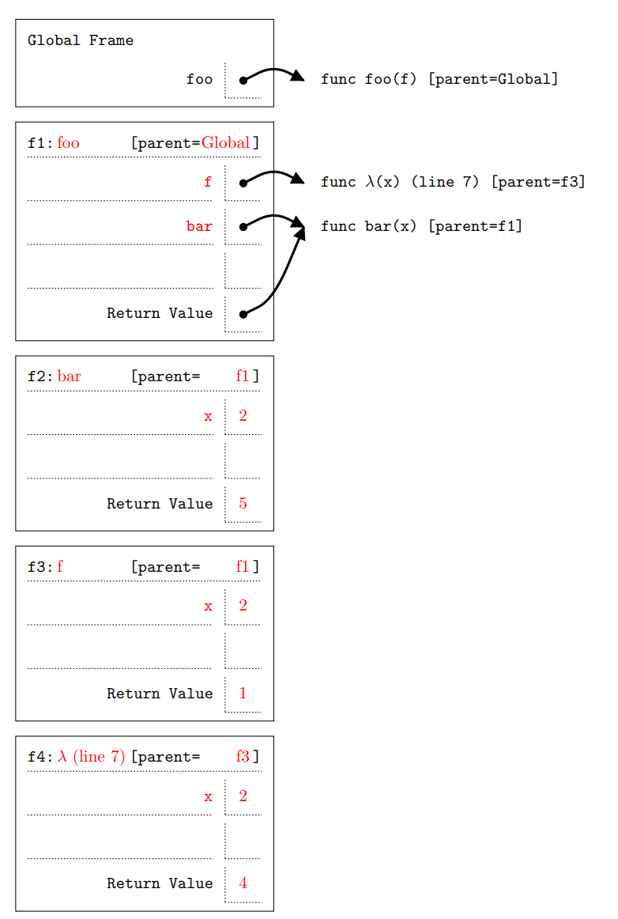

Slide 22
Is nonlocal necessary?
Consider the following:
Do I need to change a binding in a parent frame? → use nonlocal Do I just need to access a variable? → don’t use nonlocal
If I need to change the value a name is bound to: Is it possible to mutate (i.e. append, extend, or += for lists)? → don’t use nonlocal If I can’t use mutation methods → use nonlocal
Is the variable we want to make nonlocal inside nested functions? → use nonlocal

Slide 23
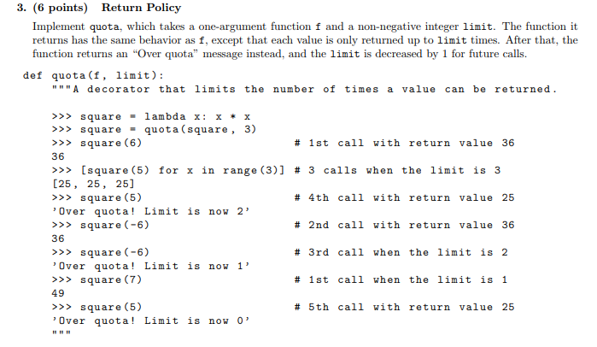
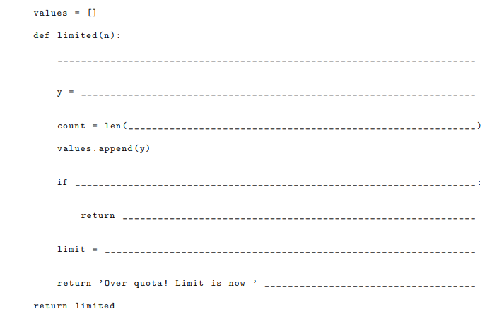
Fall ‘16
Midterm 2

Slide 24
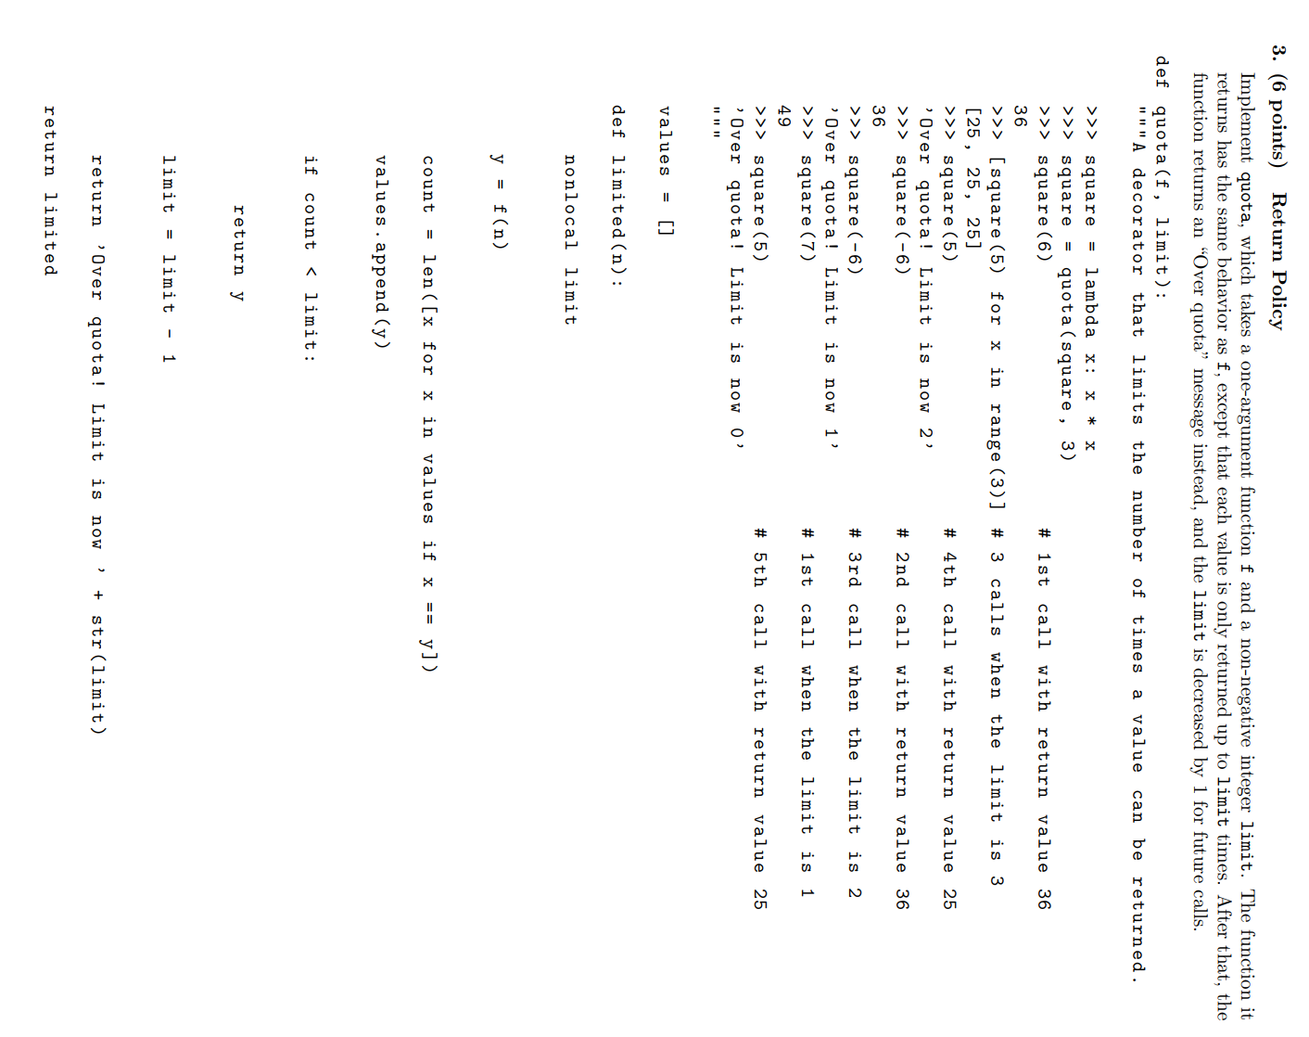

Slide 25
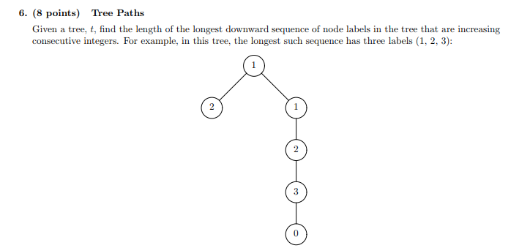
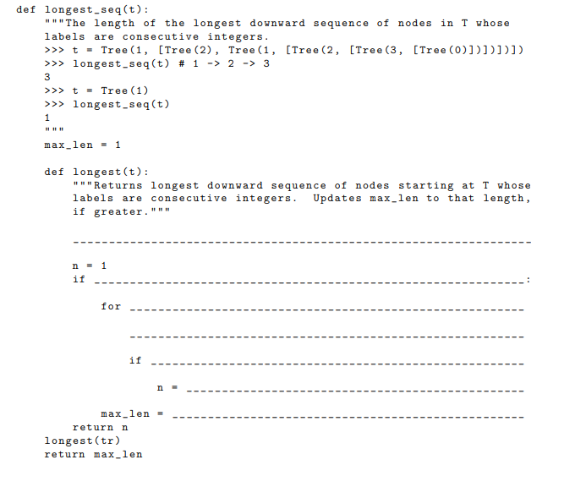
Spring ‘17 Midterm 2

Slide 26
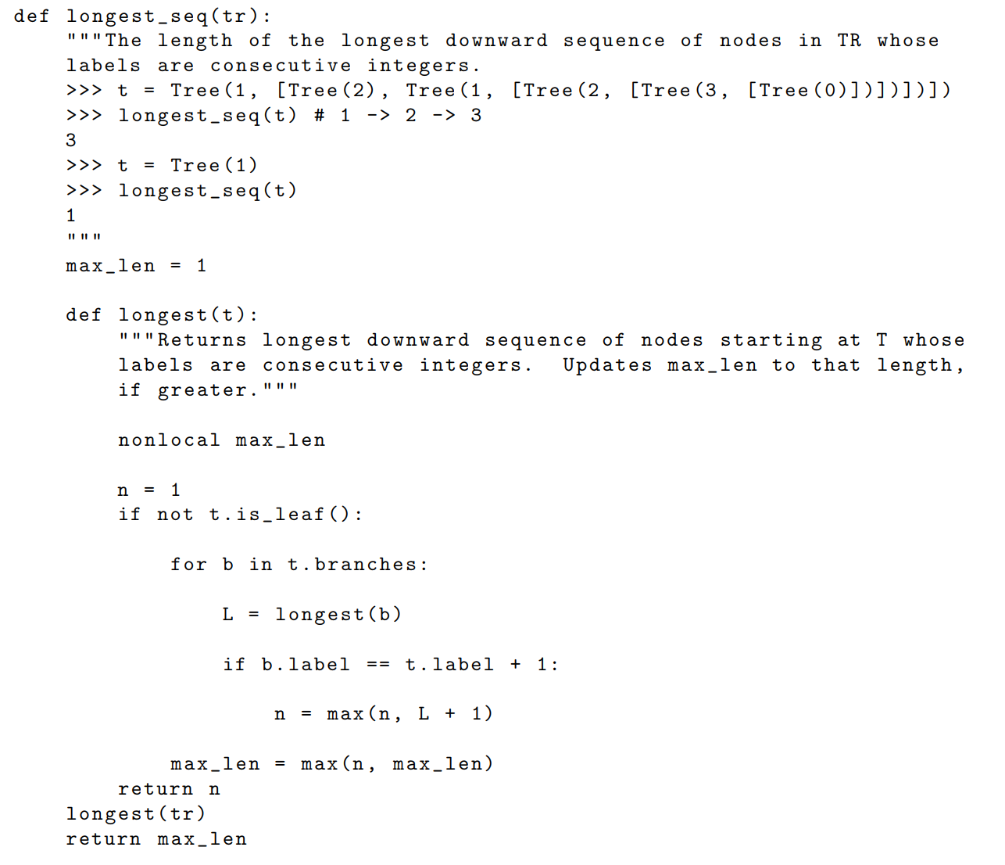

Slide 27
Questions?
Notes:
From discussion: ask students what this does

Slide 28
We’re done!
Good luck everyone! : )
Questions?
Piazza
Email jennyjwang@berkeley.edu

